Slide 2
Final year presentation
Vehicle Anti-Theft System using GSM & GPS with Fingerprint Verification
NIMALAN A/L GUNALAN 1106161002
BACHELOR OF COMPUTER ENGINEERING (HONS)
Supervisor : Ms. Aparna Vyakarnam

Slide 3
Contents
1. INTRODUCTION
2. LITERATURE REVIEW
3. METHODOLOGY
4. IMPLEMENTATION AND RESULT
5. DISCUSSION AND CONCLUSION

Slide 4
CHAPTER
1
INTRODUCTION

Slide 5
1.1 Background of Study
The simplest way of defining a security system is, where it is a technique or methods that are set to provide protection from hostile forces with the help of a machine of interworking components and devices [1].
The usual security features that are available in a car is a key and an alarm system.
Another method used to avoid car theft is by using the immobilizer.
Early models used a static code in the ignition key which was recognized by an RFID loop around the lock barrel and checked against the vehicle's engine control unit (ECU) for a match. If the code is unrecognized, the ECU will not allow fuel to flow and ignition to take place.
Later models use rolling codes or advanced cryptography to defeat copying of the code from the key or ECU [2].
Due to technology advancement it brings helpful effects and harmful effects.

Slide 6
1.2 Problem Statement
Number of stolen vehicles is increasing day by day [3].
There is no efficient security system to check if the vehicle has stolen.
There is no additional verification feature in the existing vehicles besides the car key, alarm etc.
The current security system is not able to recognize if the car has been used or driven by an unauthorized person.
The current security system is not able to informs the authorized user its location.

Slide 7
1.3 Objectives
The aim of this project is to develop a prototype of anti-theft system for vehicle which can reduces vehicle theft and locate the vehicle.
The objectives of the project are the following:
To provide a biometric authentication to start the vehicle.
To develop a system that is capable of tracking the vehicle.
To develop a system which can send real-time information to the user

Slide 8
1.5 Scope of Project
This system is mainly focusing on improving security system of any type of car.
This system will utilize the mobile communication system (GSM) to communicate with the user within Malaysia.
This system concentrates on using biometrics recognition for enhance the security features.
This system is developed to be a user-friendly system, where it allows the user to use the system with some simple procedures

Slide 9
CHAPTER
2
LITERATURE REVIEW

Slide 10
2.1 GSM-based Security for Vehicle
AUTHOR & YEAR | OBJECTIVE(S) | COMPONENTS USED | DESCRIPTION | LIMITATION
Sankirna Joge (2018) [5] | Detecting vehicle theft and informs the owner about the theft of their vehicle | Microcontroller Unit- AT MEGA 16 GSM modem IR sensor | The main function of the system is to start the engine when it receives SMS saying “UNLOCK” and when it receives SMS saying “LOCK” it will demobilize the car and activates the security system. Where the security system continuously waits for the IR sensor detects any motion or if any switches are pressed, if any of the above conditions are meet it turn on the buzzer and sends an alert SMS to the user mobile. | The user can only start the car’s engine by sending SMS to the system and this might cost more for the user

Slide 11
2.2 Anti-Vehicle Theft System using GSM and GPS with Image Acquisition
AUTHOR & YEAR | OBJECTIVE(S) | COMPONENTS USED | DESCRIPTION | LIMITATION
Samuel Farayola Kolawole and Alexander Zakari (2017) [6] | To capture the image of the driver’s face if the system detects that the vehicle has been stolen | ATmega 2560 Microcontroller GSM and GPS module Camera | The system activates when the vehicle is started. A five minutes time frame is given for the driver to press a secret button. When this button is pressed after the start of the engine, the alarm mode is disabled but the coordinates of the vehicle would still be transmitted at every fifty minutes. If the secret button is not pressed after five minutes, the vehicle is considered stolen and immediately enters security bridge mode. At this point, the camera which is place hidden in the vehicle captures the driver facial image. Simultaneously, the GPS module picks the coordinate (location) of the vehicle. The image and coordinate are stored in the microcontroller memory before being transmitted to a remote location. | This system only captures the driver's image if the vehicle is turned on The sending an image to a server or an email will require a strong network connection else the image will be transmitted slow than expected.

Slide 12
2.3 Anti-Car Theft System using Android Phone
AUTHOR & YEAR | OBJECTIVE(S) | COMPONENTS USED | DESCRIPTION | LIMITATION
Jake M. Laguador, Moulle M. Chung, Frina Joy D. Dagon, Julie Ann M. Guevarra, Rommel J. Pureza, Jeffrey D. Sanchez, and Dan Kenneth I. Sta. Iglesia (2013) [7] | To detect intrusion if the driver’s door is forcefully opened | Android platform GPS Module Shield Gizduino Atmega328 GSM Module, Internet Protocol Camera Android Phone | When this system is initialized it continuously checks for the signal form the door lock and if it receives any, the microcontroller will be triggered and sends an alert SMS saying “Intruder Alert” with the coordinates (location). As for android application, when it is launched on the phone by the user their can check for their vehicles location by clicking the navigation button and if any SMS received the phone will be alarmed. When the phone is alarmed the user can open the IP camera to view. | User has to manually connect and disconnect the power supply to activate and disactivated the security system. The application only detects for SMS alert only if the application is running in the foreground.

Slide 13
2.4 Improving the security system of a vehicle using Raspberry Pi
AUTHOR & YEAR | OBJECTIVE(S) | COMPONENTS USED | DESCRIPTION | LIMITATION
Samir Rana Ritu Mewari and Lata Nautiyal (2018) [8] | To design a security system that is capable of avoiding the vehicle from being driven away by an unauthorized user. | Hardware Raspberry Pi B+ model jaw gripper wi-fi dongle integrated circuit (L239D) Software Android development kit Python and java programming language | This system continuously detects if there is anyone tries to steal or tamper the car once this system is activated. If there is anything detected this system will send a warning signal to the database using internet connection. And on the other side, the user will have the android application installed in their phone, where this application will notify them about the theft attempt. After receiving this warning, the user has the privilege of locking the brake and accelerator by selecting the options in the application to lock with the help of the jaw gripper installed in the vehicle. | This system does not provide any information related to the location of the vehicle if the vehicle has been stolen This system does not provide any internet connection for the system to access and send the warning message

Slide 14
2.5 Vehicle Anti-Theft System Using Fingerprint Recognition Technique
AUTHOR & YEAR | OBJECTIVE(S) | COMPONENTS USED | DESCRIPTION | LIMITATION
Z.Brijet, B.Santhosh Kumar and N.Bharathi (2017) [9] | To develop a system which can verify the authorize user by uniquely identifying the user’s fingerprint to switch on the ignition on. | Arduino fingerprint sensor relay voltage regulator | Once the system is initialized, this system waits for authorized user’s fingerprint to be read. If the system is feed with the matched fingerprint, it activates the relay that is connected to the ignition system of the car which turns on the engine of the car or else it will not allow the ignition to take place. | This system does not provide any information if anyone tries to steal the car

Slide 15
CHAPTER
3
METHODOLOGY

Slide 16
3.1 System overview
This system is fully controlled by a microcontroller, Arduino Mega.
The system uses biometric fingerprint scanner to enhance the security features.
The system also have few other features such as:
Informing the authorized user about vehicle’s location on demand,
Sending and receiving SMS (Short Message Services) as it is the main channel of communication between the user and the system,
Retrieving the current location of the vehicle by using the GPS (Global Positioning System) module.
This system also provides an additional feature that allow authorized users to a switch on the ignition even when the fingerprint does not match for some flexibility.

Slide 17
3.2 System design
This system is developed using various technologies, which works together in order to run the anti-theft system for a vehicle.
The most suitable microcontroller chosen for this project is the Arduino Mega 2560 R3.
It has enough flash memory to store the codes and has the necessary processing power to execute the required programs.
It can be easily programmed by using its IDE (Integrated Development Environment) software for coding and uploading the program codes on it.

Slide 18
3.2 System design
Other than that, this system also requires other hardware components. Each component has its own important role in order to complete the system.
In this project, a GSM SIM808 module is being used where it has three main function in it, it has the functionality of GSM communication, GPS for detecting the location of the device and a Bluetooth transmitter and receiver.
For this project only the GSM communication and the GPS functions will be used.

Slide 19
3.2 System design
Relays are is used in this project to mainly act as a switch.
As the Arduino microcontroller is only capable of receiving input signal as high as five volts (5V), this situation requires a relay to detect the higher voltage flow and send a 5 volts signal to Arduino for processing and vice versa.
This system requires two types of relays which are:
The 12 volts relay is used to detect the higher voltage flow and send 5 volts signal to the Arduino.
Likewise, the 5 volts relay is used to detect signal of 5 volts send from the Arduino and switches on the higher voltage power supply.

Slide 20
3.2 System design
An Adafruit fingerprint scanner is used to scan the fingerprints in this project.
This module also comes with a flash memory which can store up to 120 images.
Hence, it reduces the memory consumption of the Arduino microcontroller.
This device is used for fingerprint enrolment and verification purposes.
This project also includes a 4x5 keypad which contains numeric values 0 to 9 and signs of ‘F1’, ‘F2’, ‘#’, ‘*’, ‘↑’, ‘↓’, ‘←’, ‘→’, ‘Esc’, and ‘Ent’.
This keypad is mainly included to authenticate unauthorized users by entering the systems PIN code.

Slide 21
3.2 System design
LCD is used to display the instructions and comment for the user.
By having this display in the system, the user will be able to use the system more easily.
As a back-up plan, a 12 volts battery pack is attached to the system in case the main power supply fails.
Since the main power source connected to the system to power it up these batteries will not be used and only be as a standby.

Slide 22
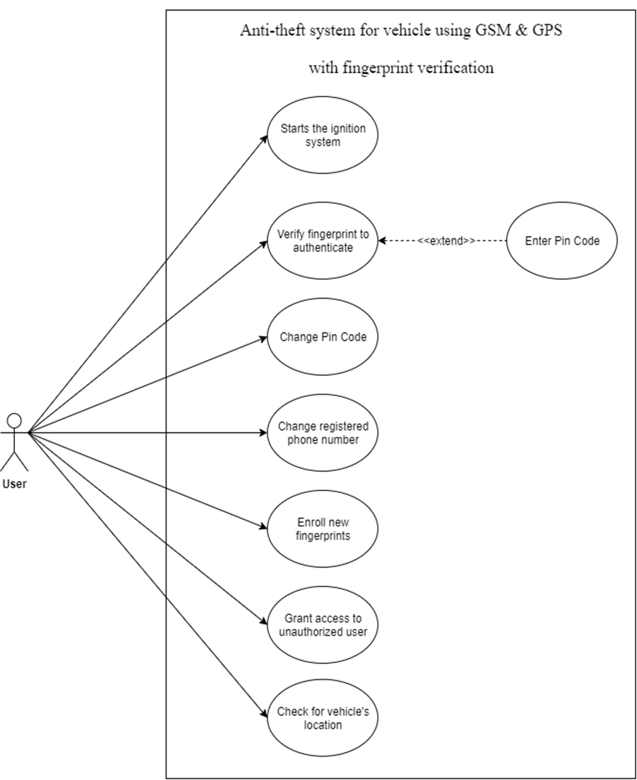
3.2 System design
Use Case Diagram: Vehicle Anti-theft System

Slide 23
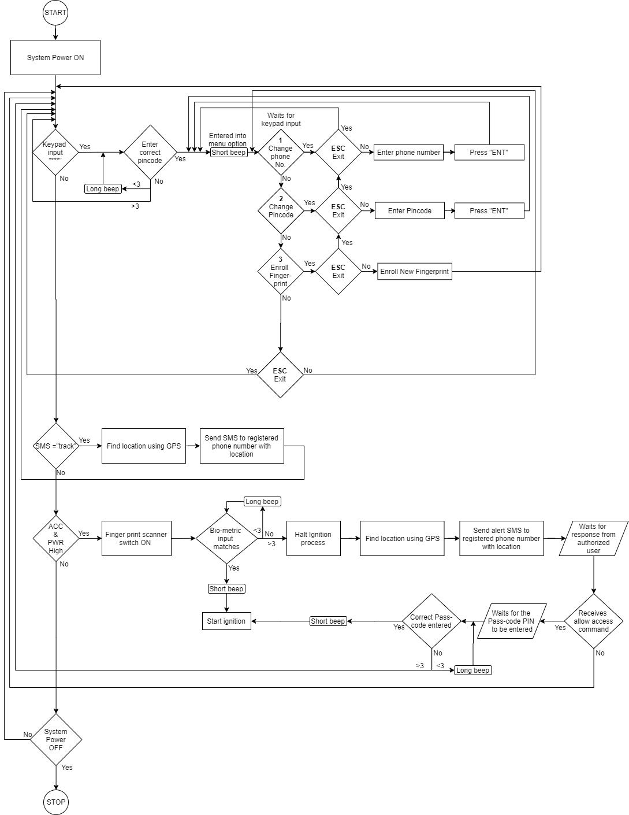
3.2 System design
Flowchart: Vehicle Anti-Theft System

Slide 24
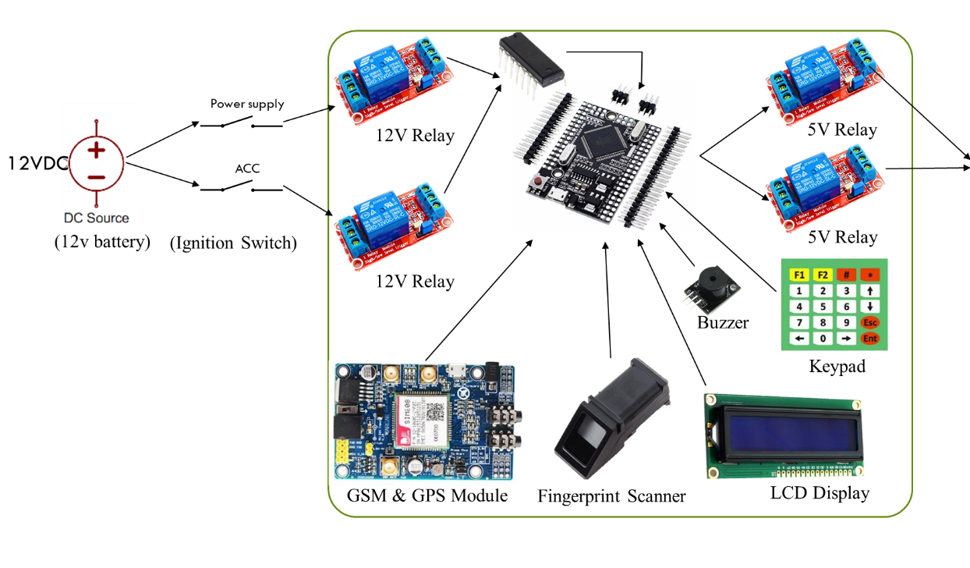
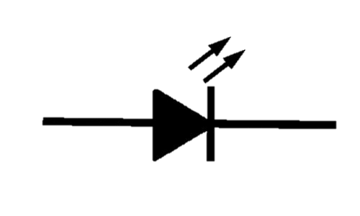
3.3 System Architecture
(Ignition coil)
Block Diagram: Vehicle Anti-theft System

Slide 25
3.3.1 Required Hardware Components
Arduino Mega
GSM SIM808 module
Fingerprint Scanner
5V Relay (x2)
12V Relay (x2)
Keypad
16x2 Liquid Crustal LCD Display
CD4081BE IC
LM 7805 Voltage Regulator
L7812CV Voltage Regulator
AMS1117 Voltage Regulator

Slide 26
3.3.2 Required Software
Arduino IDE
C/C++ Programming Language

Slide 27
CHAPTER
4
IMPLEMENTATION
AND RESULT

Slide 28
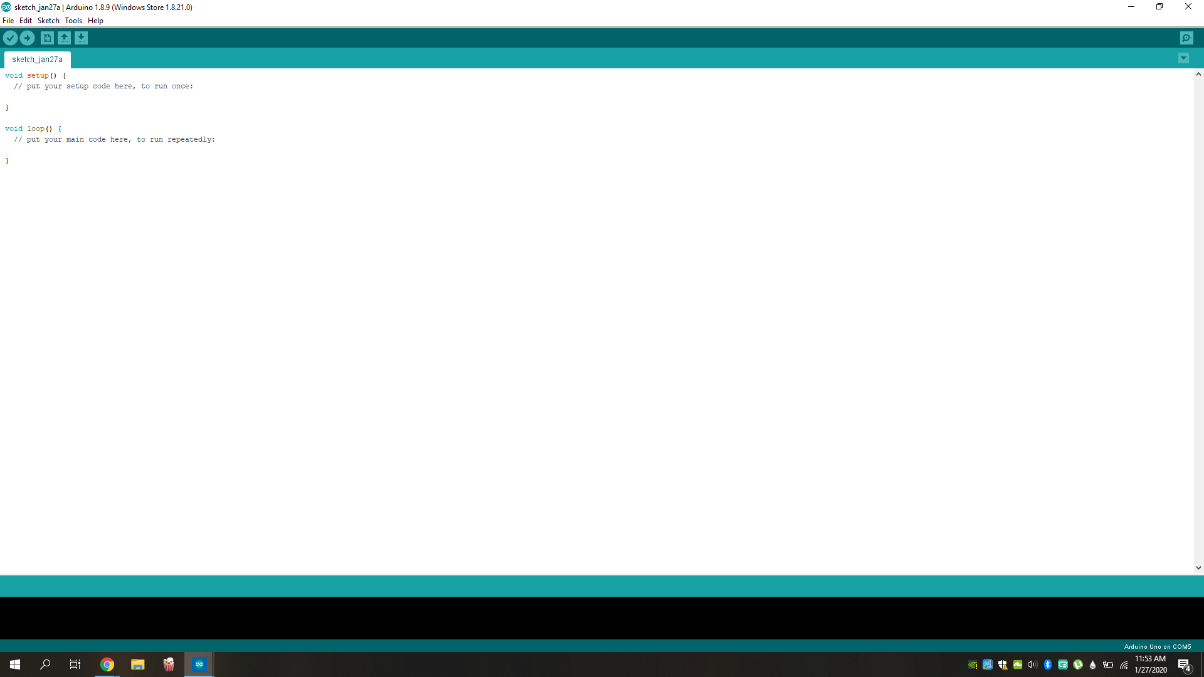
4.2 Arduino Setup
Arduino IDE was installed in the computer which was used for programming the Arduino microprocessor.
To install the IDE into computer, these are the steps to follow:
Search for the official Arduino software webpage to download the IDE software.
Download the software using this link “https://www.arduino.cc/download_handler.php.
Installed the application file into the computer.
Started the Arduino IDE software for the first time.
Figure 4.2.2: Arduino IDE user interface

Slide 29
4.3 Implementation
In this implementation step the develop process had been broken down into few sections of individual function development. This step was taken to make the development process more efficient and easier to troubleshoot if any problem arises.
Those section are:
Preparing the hardware components and its connectivity
Power supply circuit (including back up)
The fingerprint verification and fingerprint enrolment
Location detector and sending its information using SIM808 Module
Receiving physical input using Keypad
Control relays as switches.

Slide 30
4.3.1 Preparing the hardware components and its connectivity
For any system to function it needs its hardware components to be set up beforehand to proceeding further.
To set up this system all the components was gathered, and the connections was planned after researching all its pin connectivity.
Then, the circuit diagram was drawn to shows all the connectivity of these components.

Slide 31
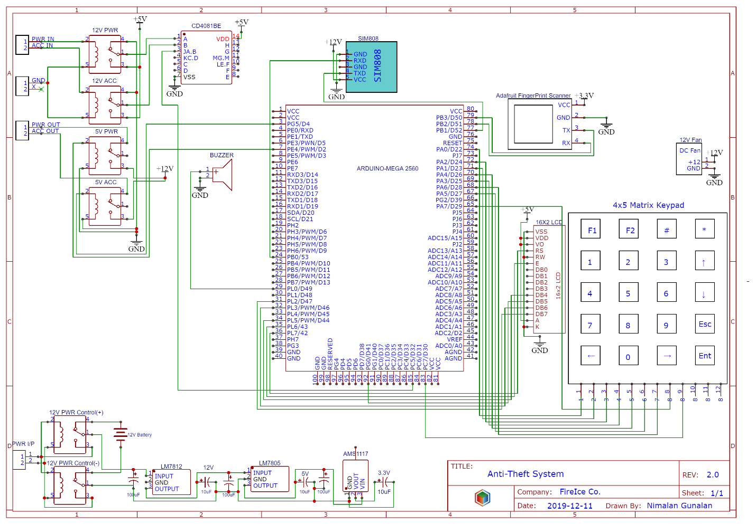
4.3.1 Preparing the hardware components and its connectivity
Figure 4.3.1.1: Circuit diagram of Vehicle Anti-theft System

Slide 32
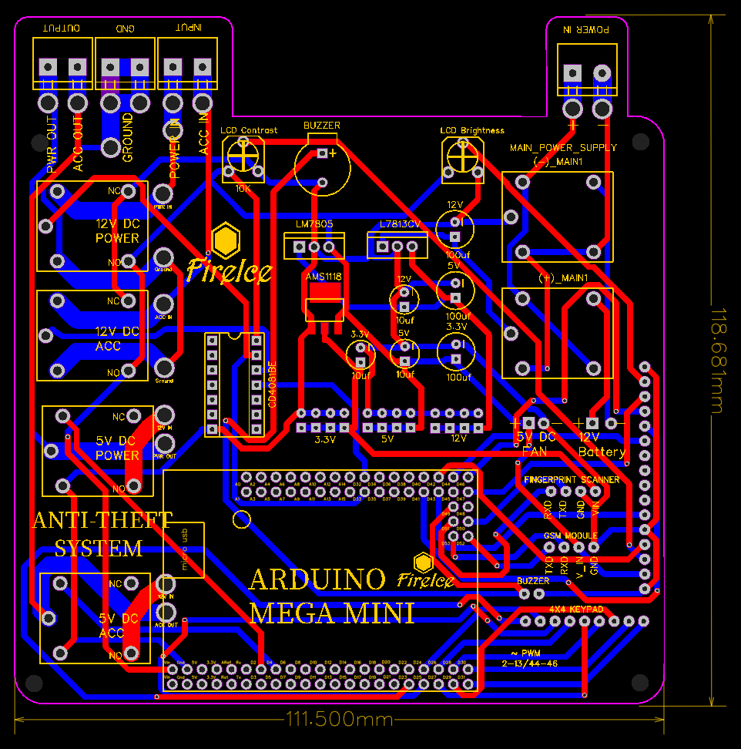
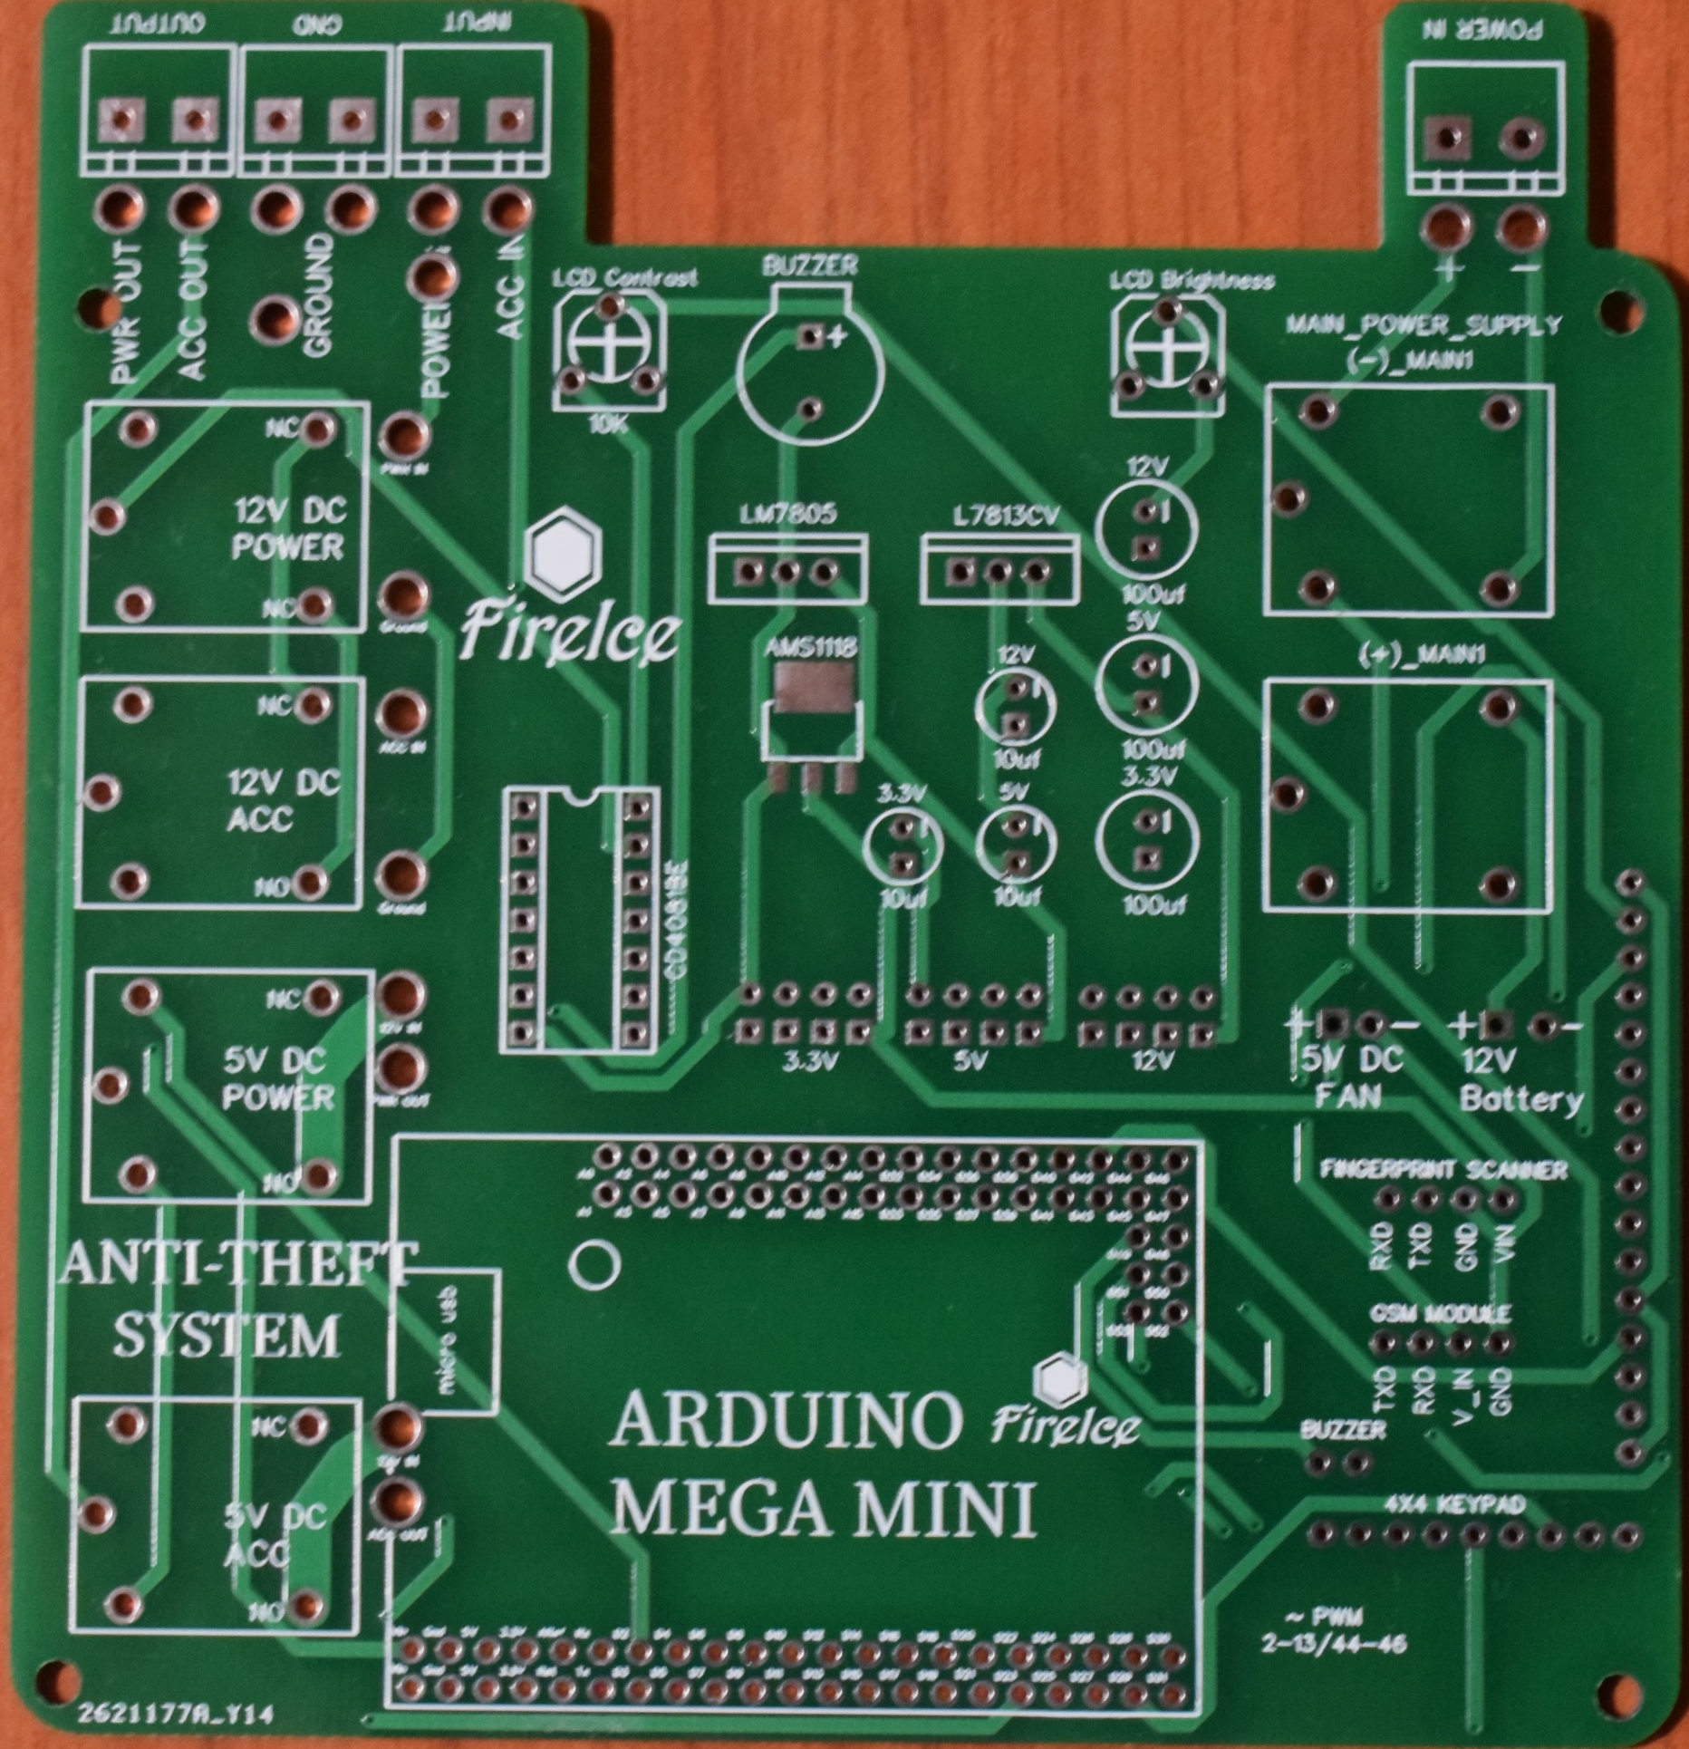
4.3.1 Preparing the hardware components and its connectivity
Using this circuit diagram, a Printed Circuit Board (PCB) design was developed and fabricated.
This PCB was developed to reduce to risk of wire failures, disconnection of circuits and this also gives a very neat finish to the system.
Figure 4.3.1.2: PCB Design of Vehicle Anti-theft System
Figure 4.3.1.3: Actual PCB of Vehicle Anti-theft System

Slide 33
4.3.2 Power supply circuit (including back up)
To power up all the components for this system, a reliable and stable power source is needed.
This prototype system has its own dedicated power source to supply regulated voltage to its components and modules.
This avoids higher voltage flow into other circuits.
In addition to that, it was also designed with a back-up power supply which is a 12V battery pack consist of 8 AA sized batteries.
The back-up batteries only kick in when the main source is disconnected or fails.

Slide 34
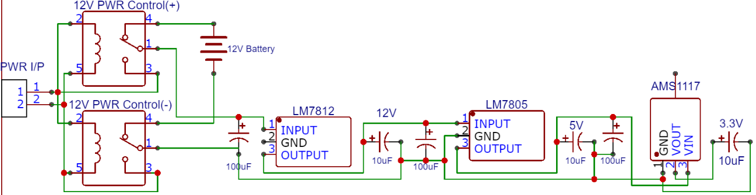
4.3.2 Power supply circuit (including back up)
Figure 4.3.2.1: Circuit diagram of the power supply circuit
Figure 4.3.2.3: Regulated Voltage Supplies
Figure 4.3.2.2: Power supply components on the PCB

Slide 35
4.3.3 The fingerprint verification and fingerprint enrolment
The fingerprint scanner is implemented in this system for two important functions:
To enroll new fingerprint for a new user.
To verify the fingerprint to start the ignition system.

Slide 36
4.3.3 The fingerprint verification and fingerprint enrolment
The first function falls under the menu option for the user.
To access this function, the user must enter the menu option in the system and enter the third option.
This function will request the user to enter the ID number which the fingerprint will be stored.
The system will wait for a valid finger to be placed on the scanner and store it on a temporary memory.
Then it ask the user to remove the finger from the scanner and place the same finger ones again to get another image of the fingerprint.
After comparing both images taken, if they are a match, the fingerprint will be stored to the system based on the ID given for it or not the system will reject the fingerprint.

Slide 37
4.3.3 The fingerprint verification and fingerprint enrolment
The second function for this fingerprint scanner is to identify the given fingerprint with all the fingerprints stored in the system.
This function is called when both the power and ignition give the output as high.
Once the function is called, it waits for a valid finger on the scanner to get an image of the fingerprint and compare the image to get a result (found or not found).
The fingerprint match is determined by the percentage of similarity between the given and the actual images in the system (0-255).
If the fingerprint was not found, the system skips other steps with notifying the user in LCD that "No FGPT Match", else the system turns ON the ignition system for 1500 milliseconds and returns to main loop.

Slide 38
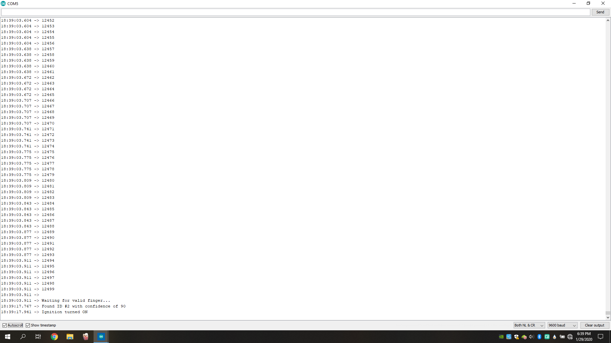
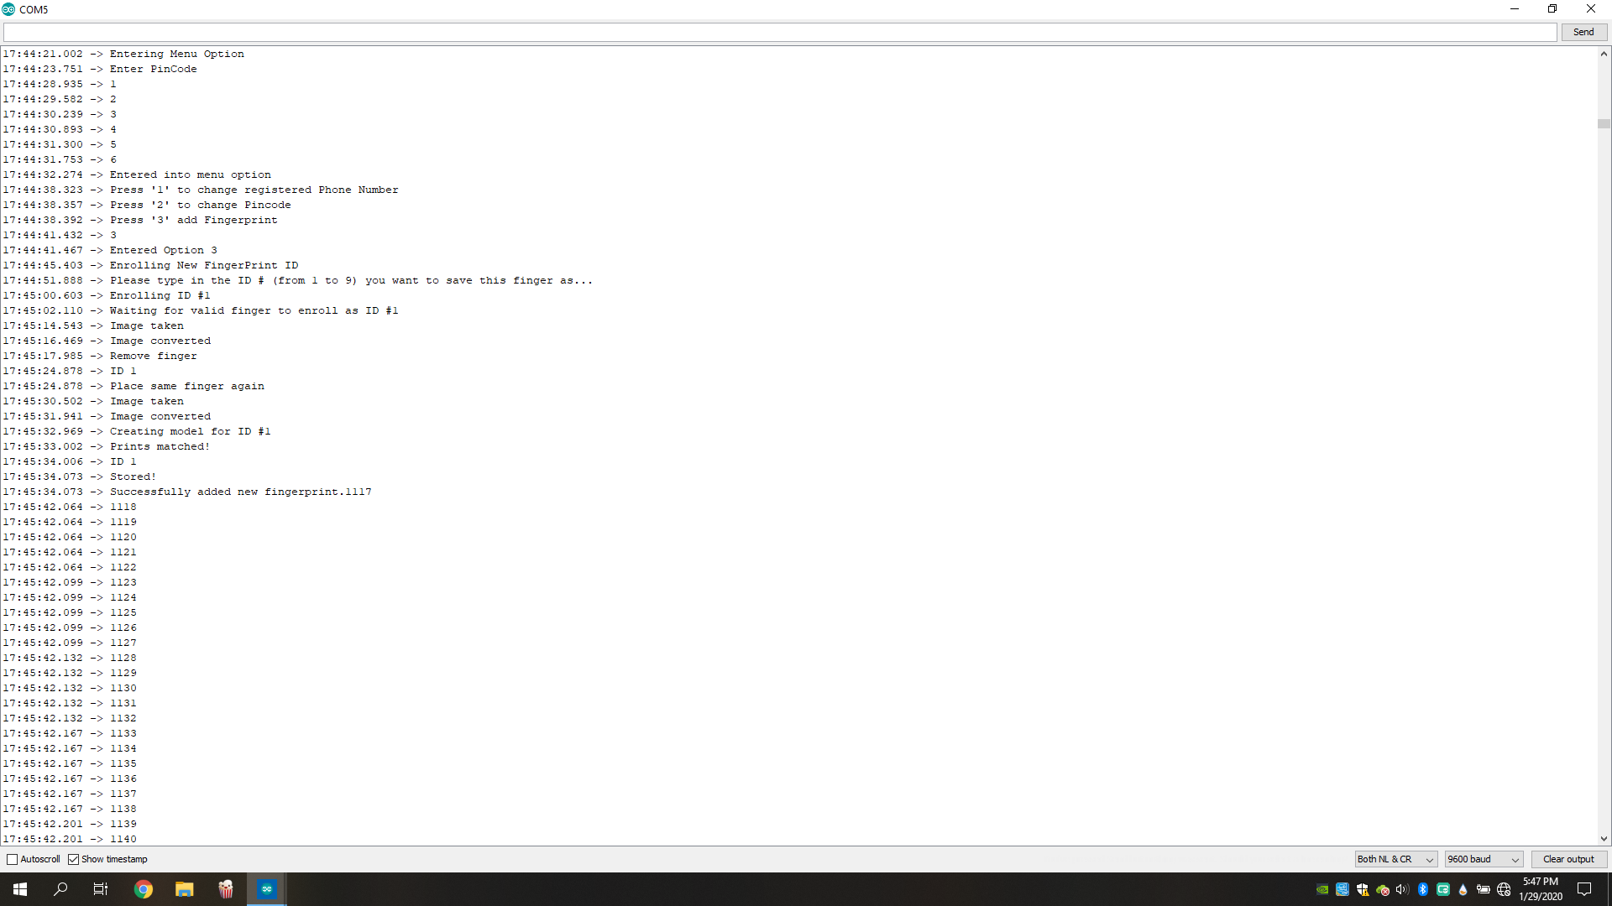
4.3.3 The fingerprint verification and fingerprint enrolment
Outputs in Command Window
Figure 4.3.3.1: Flow of new fingerprint enrolment process
Figure 4.3.3.2: Flow of fingerprint verification process

Slide 39
4.3.4 Location detector and sending its information using SIM808 Module
Location detection is a crucial part of this system, where this system collects the current location’s coordinates of the vehicle and sends the information to the authorized user.
The required hardware for both of this function to be execute is SIM808 module, since this module has the functionality of GSM for telecommunication and gathering GPS info.
There are two user defined function created based on this module for this system which are:
The “TrackingFunction”
The “AlertTrackingFunction”

Slide 40
4.3.4 Location detector and sending its information using SIM808 Module
The “TrackingFunction” is the function to check if any tracking command send from the user to the system.
If a message is received by the system this function tests two parameters:
the phone number of the sender
the keyword sent
For the phone number it compares with the registered phone in the system and for the keyword there is already a fixed keyword (“track”) to be compared.
Once both parameters have been satisfied, only then the system sends the location information to the registered phone number.

Slide 41
4.3.4 Location detector and sending its information using SIM808 Module
The “AlertTrackingFunction” will only be called when the biometric scans fail its trials for three times.
Once it is called, it halts all other functions and gathers the location coordinates information to be sent to the owner or authorized user’s phone number through SMS, then it waits for the response of the owner or authorized user.
There are only two type of message can be sent from the owner or authorized user:
“allow” to allow the ignition system to be turned on with a condition where the user in the vehicle has to enter the PINCODE of the system
And all other messages are considered as declining commands.

Slide 42
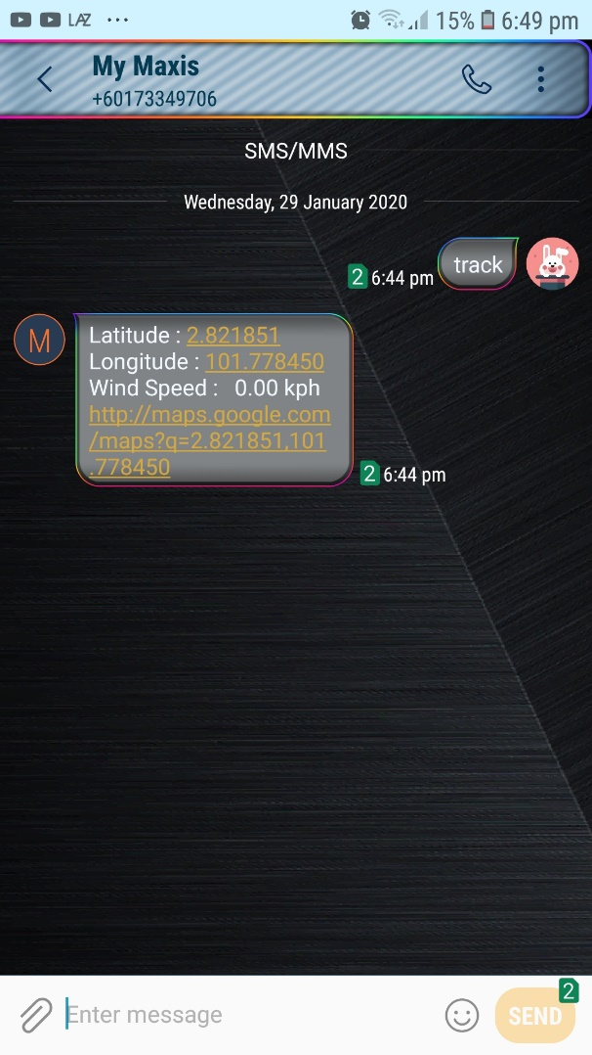
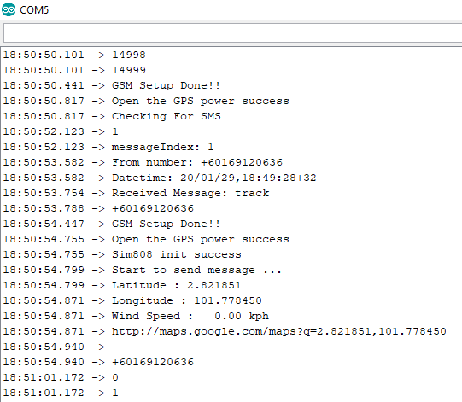
4.3.4 Location detector and sending its information using SIM808 Module
Outputs “TrackingFunction” in Command Window
Outputs “TrackingFunction” in user’s phone
Figure 4.3.4.1: Flow of “TrackingFunction”
Figure 4.3.4.2: Screenshot of “TrackingFunction” function’s output

Slide 43
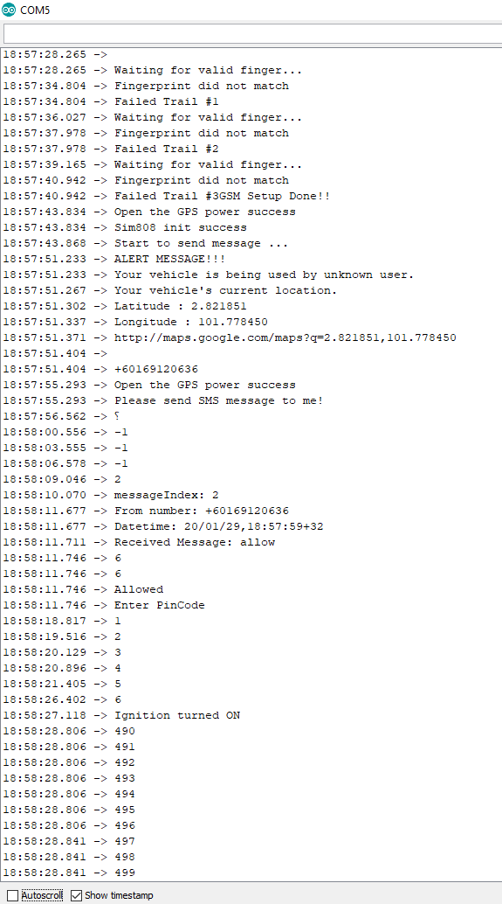
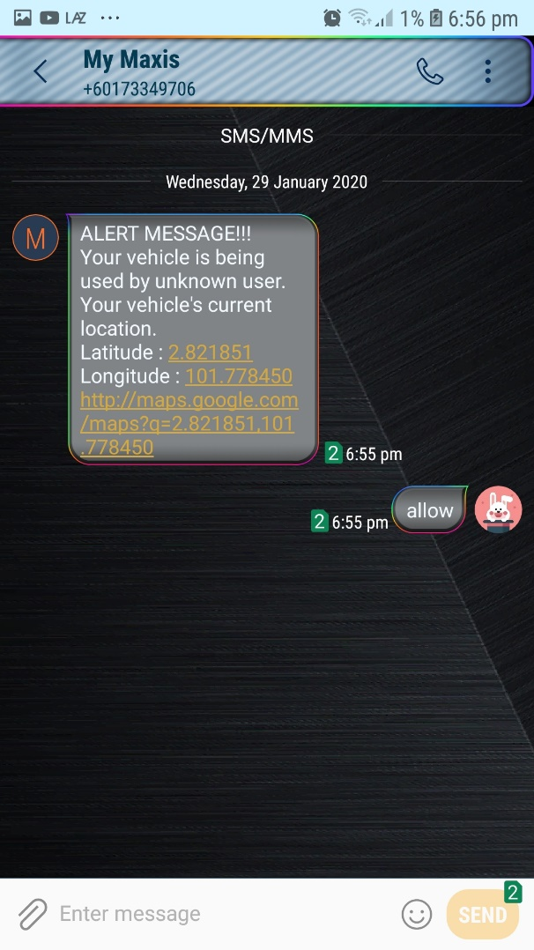
4.3.4 Location detector and sending its information using SIM808 Module
Outputs “AlertTrackingFunction” in Command Window
Outputs “AlertTrackingFunction” in user’s phone
Figure 4.3.4.3: Flow of the “AlertTrackingFunction”
Figure 4.3.4.4: Screenshot of “AlertTrackingFunction” function’s output

Slide 44
4.3.5 Receiving physical input using Keypad
It is very important to obtain input from the user, so a keypad is included as an input device with this system to make this system easier and convenient to use.
To include this keypad module there are not much to define since most of the functions are included in the Keypad.h library.
The keys of the keypad module are defined in the setup function.
To receives any input from the user, keypad.getKey() function is called.

Slide 45
4.3.5 Receiving physical input using Keypad
Function Codes for Keypad
char pincode[7];
int MenuEntries=0;
const byte ROWS = 5; //five rows
const byte COLS = 4; //four columns
char keys[ROWS][COLS] = {
{'a','b','#','*'},
{'1','2','3','u'},
{'4','5','6','d'},
{'7','8','9','Q'},
{'l','0','r','E'}
};
byte rowPins[ROWS] = {23,24,25,26,27}; //connect to the row pinouts of the keypad
byte colPins[COLS] = {31,30,29,28}; //connect to the column pinouts of the keypad
Keypad keypad = Keypad( makeKeymap(keys), rowPins, colPins, ROWS, COLS );

Slide 46
4.3.6 Control relays as switches.
Relays are used as switches in this prototype system where it is controlled automatically by the system without human effort.
There are 3 sets of relays, total of 6 relays used, 2 of sets are used to detect inputs and 1 is to control output.

Slide 47
4.3.6 Control relays as switches.
The first set used as input detection relays are to detect and manage power supply units.
Both relay’s coils are connected to main power supply.
Each of the relay is dedicated for each power terminal, (+) and (-) and connected to the Normally Open (NO) pin.
If the coil is activated the current flow from the main power source (NO) to the common pin (C) of the relays, else the relays switches from Normally Open (NO) to Normally Closed (NC) where the back-up batteries are connected.
Coil | Normally Open (NO) | Normally Close (NC) | Common | Power Source
0 | 0 | 1 | NC | BU Battery
1 | 1 | 0 | NO | Main Source
Table 4.3.6.1: Relay power input table

Slide 48
4.3.6 Control relays as switches.
The second set of input detection relays are used to detect the Power (PWR) and Ignition (ACC).
One of the relay’s coil is connected to the PWR input and the other is connected to the ACC input.
These relays are supplied with 5V to the Normally Open (NO) pin and ground (GND) is connected to the Normally Closed (NC) pin.
When the coils are activated these send 5V inputs as signals to the CD4081BE IC which is an AND gate chip, else GND.
Then this chip will send an input to the processor based on the signal sent from the relays.
Input A (PWR) | Input B (ACC) | Output A⸱B
0 | 0 | 0
0 | 1 | 0
1 | 0 | 0
1 | 1 | 1
Table 4.3.6.2: Truth table of CD4081BE IC

Slide 49
4.3.6 Control relays as switches.
The third set of relays are used to control the output of 12V power using 5V relays.
These relay’s coils are connected to the processor pin number 2 and 4.
One of the relays is to control PWR and the other is to control ACC power supply independently.
 | Coil (Status) | Common (V)
Power (PWR) | OFF | 0
 | ON | 12
Ignition (ACC) | OFF | 0
 | ON | 12
Table 4.3.6.3: Output table of ACC and PWR

Slide 50
CHAPTER
5
DISCUSSION
AND CONCLUSION

Slide 51
5.1. Discussion of Results
All three objectives has been achieved by the end of this project.
During the process of development, there were few changes in the workflow and functionality of the system was made to the proposed project earlier such as:
including a menu option for the user to modify the user data,
including a buzzer for the user to be notified and
including an LCD for the user to know the steps.
These changes were made to make the system to be better.

Slide 52
5.2 Achievement of the objectives
Below given table shows the achievement of the objectives as stated initially.
NO. | OBJECTIVES | REMARKS
1. | To provide a biometric authentication to start the vehicle. | This prototype system is equipped with fingerprint scanner to read the user’s fingerprint and compare with the registered fingerprint images in the system.
2. | To develop a system that is capable of tracking the vehicle. | A GPS module (SIM808) has been used to gather the system’s locations coordinates in order to send it to the user.
3. | To develop a system which can send real-time information to the user | Using a GSM technology (SIM808) the system was able to send real-time information to the authorized user.
Table 5.2.1: Achievement of objectives

Slide 53
5.3 Implication of study
This system can be very useful enhancement to the security features in the automobile industry.
Since this system is an additional security feature it does needs much changes in the existing vehicle’s system.
With some understanding of this system and the vehicle’s system anyone will be able to install it.
This can reduce this risk of stolen vehicle by starting the vehicle engine.
Even though if the vehicle had been hijacked, the user will be able to locate the vehicle by just sending a SMS to the system.

Slide 54
5.4 Future Enhancements
Features and functionality that can be added to this system to improve its effect and efficiency to protect the vehicle.
First of all, if this system was to be to produce in the mass production, the creation of the system needs to add a hashing system in order to create new default password unique for each and every product.
Secondly, the system has to used lithium-ion based rechargeable batteries.
By using this type of batteries, the number of time that back-up batteries needed to be changed will be reduces tremendously.

Slide 55
5.4 Future Enhancements
Next will be adding a function for the system to call an emergency contact number if any theft was attempted during the authorized user using the vehicle.
Other than that, creating a mobile application for this system will bring this system to the current Internet of Things (IOT) era.
This application can be used to monitor the vehicle’s location and activities, like who are using the vehicle and so on.

Slide 56
5.4 Future Enhancements
Lastly, integrating more security features and functionality together with this system can improve the vehicle’s and user’s security.
Other functions that can be included are ability to detect any forceful door breakage and glass breakage and adding external cameras surrounding the vehicle for monitoring the vehicles surroundings and internals for capture images or record videos if any theft attempt was detected.

Slide 57
5.5 Conclusion
Understanding the importance of the security in the field in automobile industry is crucial to manufactures and to the users of it.
The implementation of this system in the actual world is very wide in the coming future according to the vehicle theft studies.
Apparently, the demand for the vehicle security system will continuously increase in coming years.
Although security system for vehicles exists, this project is aimed to integrate multiple security measures to increase its efficiency and accuracy.
The project was successfully completed by achieving all the objectives that were listed in the beginning.

Slide 58
REFERENCE
[1] | T. Harris, "howstuffworks," 2 August 2001. [Online]. Available: https://auto.howstuffworks.com/car-alarm.htm.
[2] | Y. D. Eusebio, "autodeal," 24 April 2018. [Online]. Available: https://www.autodeal.com.ph/articles/car-features/what-engine-immobilizer-and-why-it-important.
[3] | "VTREC," November 2018. [Online]. Available: http://www.vtrec.net/?page_id=455.
[4] | "The Straits Times," 13 February 2018. [Online]. Available: https://www.straitstimes.com/asia/se-asia/cars-with-keyless-entry-system-are-easy-theft-targets.
[5] | S. Joge, "GSM BASED SECURITY FOR VEHICLE," International Research Journal of Engineering and Technology (IRJET), vol. V, no. 2, pp. 915-920, 2018.
[6] | F. K. Samuel and Z. Alexander, "Design of Anti-Vehicle Theft System using GSM and GPS with Image Acquisition," Asian Journal of Engineering and Technology, vol. 05, no. 04, pp. 82-92, 2017.
[7] | J. M. Laguador, M. M. Chung, F. J. D. Dagon, J. A. M. Guevarra, R. J. Pureza, J. D. Sanchez and D. K. I. S. Iglesia, "Anti Car Theft System using Android Phone," INTERNATIONAL JOURNAL OF MULTIDISCIPLINARY SCIENCES AND ENGINEERING, vol. 4, no. 5, pp. 12-14, 2013.
[8] | R. Samir, M. Ritu and N. Lata, "Anti theft Security System for Vehicles," International Journal of Engineering & Technology, vol. 7, no. 4.12, pp. 42-46, 2018.
[9] | Z. B. Kumar and N.Bharathi, "Vehicle Anti-Theft System Using Fingerprint Recognition Technique," Open Academic Journal of Advanced Science and Technology, vol. 1, no. 1, pp. 36-41, 2017.
[10] | "BEN," sparkfun, 9 November 2011. [Online]. Available: https://learn.sparkfun.com/tutorials/what-is-an-arduino/all#whats-on-the-board.
[11] | Itead, "itead.cc," itead, 2016 August 8. [Online]. Available: https://www.itead.cc/wiki/SIM808_GSM/GPRS/GPS_Module.
[12] | espruino, "espruino.com," [Online]. Available: https://www.espruino.com/KeyPad.
[13] | D. Dunmur and H. G. Walton, "Encyclopaedia Britannica," Britannica, 28 May 2004. [Online]. Available: https://www.britannica.com/technology/liquid-crystal-display. [Accessed 03 August 2015].
[14] | Texas Instrument, [Online]. Available: https://www.ti.com/store/ti/en/p/product/?p=CD4081BE.
[15] | "arduino.cc," Arduino, 7 September 2015. [Online]. Available: https://www.arduino.cc/en/Guide/Environment.
[16] | RishabhPrabhu, "geeksforgeeks," [Online]. Available: https://www.geeksforgeeks.org/c-language-set-1-introduction/.
[17] | "Safewise," [Online]. Available: https://www.safewise.com/home-security-faq/how-do-security-systems-work/.
[18] | M. Bullock, "howstuffworks.com," [Online]. Available: https://electronics.howstuffworks.com/relay2.htm.

Slide 59
DEMONSTRATION

Slide 60

THANK YOU
FOR YOUR TIME AND ATTENTION
Any Questions?

